Slide 1
First steps on LinkedIn

Slide 2

OBJECTIVES FOR THIS SESSION
Understand the importance of LinkedIn
Identify how you could use LinkedIn as a students
Share tips to create a LinkedIn profile

Slide 3



ENGAGE
What do you know of LinkedIn?
10 MIN
What do you already know about this social media?
How many of you already have a LinkedIn account?
What’s the difference with other social media?
What are your goals for using LinkedIn?
Notes:
TRAINER: Draw a mind-map

Slide 4


ACTIVITY 1
Explore LinkedIn
20 MIN
Create a profile (we will work on the profile during the next session)
Explore the website: How can you use it as a student?
TO COMPLETE THIS ACTIVITY :
1
GROUP EXPLORATION
(10 min)
2
CLASS DISCUSSION
(10 min)

Slide 5
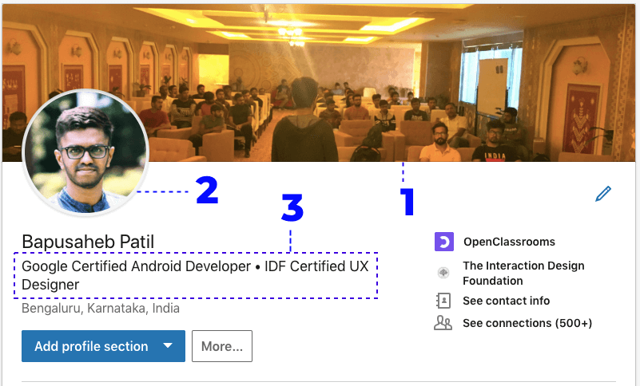
What’s a LinkedIn profile?
EXPLAIN
5 MIN
Background / banner
Profile picture
Headline

Slide 6
ACTIVITY 2
Give us tips to create an effective LinkedIn profile
25 MIN
What should be added to the following tip?
Group 1: [Profile picture
and background photo]
Group 2: [Headline]
Group 3: [Summary]
Group 4: [Experience]
Group 5: [Education]
Group 6: [Skills:]
Group 7: [Add relevant media]
Group 8: [Get recommendations]
TO COMPLETE THIS ACTIVITY :
1
GROUP DISCUSSION
(10 min)
2
CLASS PRESENTATION
(15 min)

Slide 7
EXPLAIN
Summary of the tips
10 MIN
Profile picture
Background photo
Headline
Summary
Experience
Education
Skills
Add relevant media
Get recommendations

Slide 8
ACTIVITY 3
What’s wrong with those headlines?
15 MIN
Gallery walk
You are working as a LinkedIn coach. Your trainees wrote those headlines. Identify why the drafts are not effective and help to improve them!
TO COMPLETE THIS ACTIVITY :
1
GROUP DISCUSSION
(5 min)
2
CLASS DISCUSSION
(10 min)

Slide 9
ACTIVITY 4
What’s wrong with those summaries?
15 MIN
You are working as a LinkedIn coach. Your trainees wrote those summaries. Identify why the headlines are not effective and help to improve them!
TO COMPLETE THIS ACTIVITY :
1
GROUP DISCUSSION
(5 min)
2
CLASS DISCUSSION
(10 min)

Slide 10
HOMEWORK
Create your LinkedIn profile!

